Slide 1
Session 19:
IOStreams and File IO
Dr. Naveen Kumar
Associate Professor,
Amity Institute of Information Technology,
Amity University Patna

Slide 2
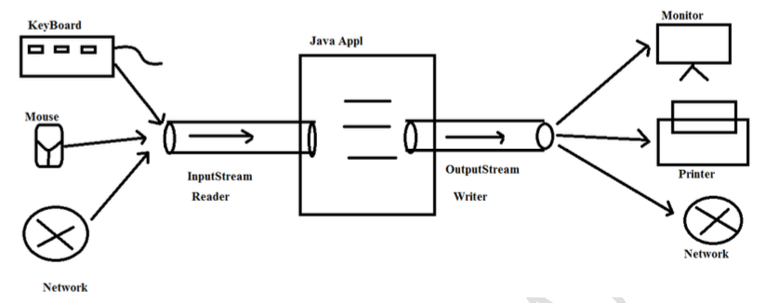
Concept of Streams

Slide 3
IOStream
In Java IOStreams are divided into following ways:
1.Byte oriented Streams.
2.Character-Oriented Streams

Slide 4
1. Byte Oriented Stream
Byte Stream allows the data in the form of bytes from input devices to Java program and from java program to output devices.
The length of the data in byte-oriented streams is 1 byte.
There are two types of Byte-Oriented Streams
i. InputStream
ii. OutputStream

Slide 5
i. InputStream
It is a byte-oriented Stream,it will allow the data in the form of bytes from input devices to Java program.
ByteArrayInputStream
FilterInputStream
DataInputStream
ObjectInputStream
FileInputStream
StringBufferInputStream
BufferedInputStream....

Slide 6
ii. OutputStream
It is a byte-oriented Stream,it will allow the data in the form of bytes from Java programmes to output devices.
ByteArrayOutputStream
FilterOutputStream
DataOutputStream
FileOutputStream
PrintStream
BufferedOutputStream..
NOTE:All the ByteOrientedStream classes are ends with "Stream" word.

Slide 7
2. Character Oriented Streams
These Streams allows the data in the form of characters from input devices to java program and form java program to output devices.
The length of the data in characters-oriented stream is 2 bytes. There are two bytes of character-oriented streams 1.Reader 2.Writer

Slide 8
i. Reader
The character-oriented stream allows the data in the form of characters from input devices to java program.
CharArrayReader
FilterReader
BufferedReader
FileReader
InputStreamReader ....

Slide 9
ii. Writer
The character-oriented stream allows the data in the form of characters from java program to output devices.
Ex:
CharArrayWriter
FilterWriter
FileWriter
PrintWriter
BufferedWriter....
NOTE:All the predefined Classes of character-oriented streams are ends with either Reader or Writer.

Slide 10
FileOutPutStream:
The byte-oriented Stream used to transfer the data from Java program to a particular target file.
To transfer the data from Java program to a particular target file by using FileOutPutstream we have to use the following Steps.
1.Create FileOutPutStream between Java programme and target file:
FileOutPutStream constructors:
public FileOutPutStream(String target_File)
public FileOutPutStream(String target_File,boolean b)
Ex:
FileOutPutStream fos=new FileOutPutStream("abc.txt");
It will overwrites the existed data in the target file at each and every write operation.

Slide 11
FileOutPutStream fos=new FileOutPutStream("abc.txt",true);
It will not overwrite the existed data in the target file, it will append the specified new data to the existed data in the target file.
When JVM encounter the above instruction, JVM will perform the following tasks.
a)JVM will take the specified target file. b)JVM will search for the specified target file at the respective location.
c)If the specified target file is available then JVM will establish FileOutPutStream from java program to target file.
d)If the specified target file is not available then JVM will create a file with the target file name and establish FileOutPutStream from Java program to target file.

Slide 12
2)Declare the data and convert into byte[]:
String data="Hello";
byte[] b=data.getBytes();
3)Write Byte Array data into FileOutPutStream:
To write byte[] data into FileOutPutStream, we have to use the following method.
public void write(byte[] b) throws IOException
Ex:
fos.write(b);
4)Close FileOutPutStream:
fos.close();

Slide 13
2.FileInputStream:
It is a byte-oriented Stream, it can be used to transfer the data from a particular source file to Java Program.
If we want to transfer the data from source file to java programme by using FileInputStream, we have to use the following Steps:
1.Create FileInputStream class Object:
To create FileInputStream constructor from java.io.FileInputStream class.
public FileInputStream(String file_name) throws FileNotFoundException
Ex:
FileInputStream fis=new FileInputStream("abc.txt");

Slide 14
When JVM encounter the above instruction then JVM will perform the following actions.
1. JVM will take the specified source file name.
2.JVM will search for the specified source file at the respective location.
3.If the source file is not available at the respective location then JVM will raise an excpetion like "java.io.FileNotFoundException".
4.If the required source file is available then JVM will establish FileInputStream from source file to JAVA program.
5.After creating FileInputStream,JVM will transfer the data from source file to FileInputStream in the form bytes.

Slide 15
2.Get the size of the data from FileInputStream and prepare byte[] with the data size:
To get the size of the data from FileInputStream,we have to use the following method
public int available() Ex: int size=fis.available(); byte[] b=new byte[size];
3.Read the data from FileInputStream into byte[]:
To read the data from FileInputStream into byte[], we have to use the following method.
public void read(byte[] b)throws IOException
Ex:
fis.read(b);

Slide 16
4.Convert data from byte[] to String:
String data=new String(b); System.out.println(data);
5.close FileInputStream:
fis.close();

Slide 17
Write a Java program to display a particular file content on command prompt by taking filename as command line input?
Write a Java program to count no of words available in a particular text file and how many times the word "is" is repeated?
Write a Java program to copy an image from a source file to a particular target file?

Slide 18
FileWriter:
This character-oriented Stream can be used to transfer the data from Java Application to a particular target File.
If we want to transfer the data from java application to a particular target file by using FileWriter then we have to use the following steps:
1.Create FileWriter object:
FileWriter constructor.
public FileWriter(String target_File)
Ex:
FileWriter fw=new FileWriter("abc.txt");
It will overwrites the existed content with the new content at each and every write operation.
public FileWriter(String target_File,boolean b)
Ex:
FileWriter fw=new FileWriter("abc.txt",true);
It will append new content to the existed content available in the file at each and every write operation.

Slide 19
When JVM encounter the above instructions,
JVM will take the specified file and JVM search for the specified file at the respective location.
if the required target file is available then JVM will establish FileWriter from Java application to the target file.
If the required target file is not available at the respective location then JVM will create a new file with the same specified file name and establish FileWriter from Java application to the target file.
2.Declare the data which we want to transfer and convert that data into char[]:
String data="Hello"; char[] ch=data.toCharArray();

Slide 20
3.Write char[] data into FileWriter:
To write char[] data into FileWriter,we have to use the following method.
public void write(char[] ch)throws IOException Ex:fw.write(ch);
4.Close FileWriter:
fw.close();

Slide 21
import java.util.*; public class FWEx{ public static void main(String args[])throws Exception{
FileWriter fw=new FileWriter("abc.txt",true);
String data=”Welcome to Amity University";
char[] ch=data.toCharArray();
fw.write(ch); fw.close();
}
}

Slide 22
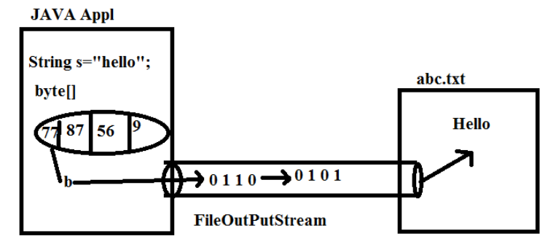

Slide 23
FileReader:
This character-oriented stream can be used to transfer the data from a particular source file to Java program.
If we want to transfer the data from a particular source file to Java program by using FileReader then we have to use the following steps:
1.Create FileReader class Object:
To create FileReader class object,we have to use the following constructor.
public FileReader(String file_Name)throws FileNotFoundException
Ex: FileReader fr=new FileReader("abc.txt");

Slide 24
when JVM encounter the above instruction, JVM will perform the following steps.
a)JVM will take source file name from FileReader constructor.
b)JVM will check whether the specified file is available or not at the respective location.
c)If the specified source file is not available at the respective location then JVM will rise an exception like "java.io.FileNotFoundException".
d)If the specified file is existed at the respective location then JVM will establish FileReader from source file to Java program.
e)After creating FileReader, JVM will transfer the content of source file to FileReader object in the form of characters.

Slide 25
2.Read data from FileReader:
To read data from FileReader, we have to use the following steps.
a)Read character by character from FileReader in the form of ASCII values.
b)Convert that ASCII values into the respective characters.
c)Append the converted characters to a String variable.
Repeat the above steps upto all the characters which are available in the respective source file or upto the end-of-file character i.e "-1".
To read an ASCII value from FileReader, we have to use the following method.
public int read() throws IOException
3.Close FileReader:
fr.close();

Slide 26
import java.util.*; public class FREx{ public static void main(String args[])throws Exception{
FileWriter fr=new FileWriter("abc.txt");
String data=""; int val=fr.read(); while(val!=-1){
data=data+(char)val;
val=fr.read(); } System.out.println(data);
fr.close();
}
}

Slide 27
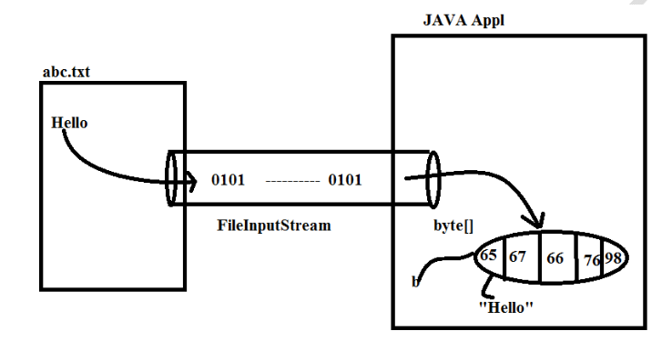

Slide 28
Write a JAVA programme to copy a document from one file to another file by using character oriented Streams?

Slide 29
Approaches for dynamic input:
There are three approaches to provide dynamic input in java applications.
1.BufferedReader 2.Scanner 3.Console

Slide 30
1.BufferedReader:
If we want to take dynamic input by using BufferedReader in java applications then we have to use the following statement.
BufferedReader br=new BufferedReader(new InputStreamReader(System.in));
where "in" is static variable, it will refer a predefined "InputStream" object which is connected with command prompt.
If we provide data on command prompt then that data will be transfered to InputStream object in the form of binary data.
where "InputStreamReader can be used to convert the data from binary representation to character representation.
where BufferedReader can be used to improve the performance of Java application while performing input operation.

Slide 31
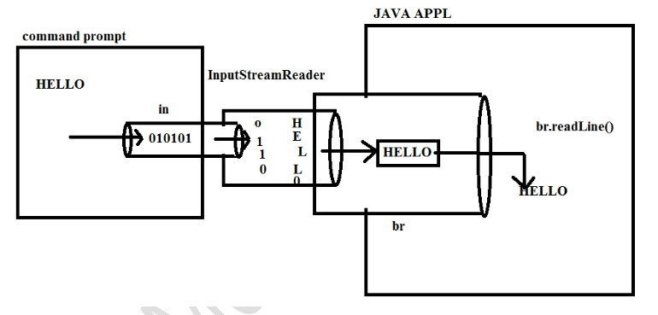

Slide 32
To read the data from BufferedReader, we will use the following method
1.readLine()
2.read()
readLine() method will read a line of text from command prompt [BufferedReader] and it will return that data in the form of String.
public String readLine() throws IOException
read() method will read a single character from command prompt [BufferedReader] and it will return that character in the form of its ASCII value.
public int read()throws IOException

Slide 33
import java.io.*;
public class BufferedReaderEx{
public static void main(String args[])throws Exception{
BufferedReader br=new BufferedReader(new InputStreamReader(System.in));
System.out.println("Enter Text :");
String data1=br.readLine();
System.out.println("Enter the same text again :");
int data2=br.read(); System.out.println("First Entered :"+data1); System.out.println("Second Entered :"+data2+"--->"+(char)data2);
}
}

Slide 34
public class BufferedReaderEx{
public static void main(String args[])throws Exception{
BufferedReader br=new BufferedReader(new InputStreamReader(System.in));
System.out.println("First value :");
String val1=br.readLine();
System.out.println("Second value :");
String val2=br.readLine();
System.out.println("Addition :"+val1+val2);
}
}

Slide 35
public class BufferedReaderEx{
public static void main(String args[])throws Exception{
BufferedReader br=new BufferedReader(new InputStreamReader(System.in));
System.out.println("First value :");
String val1=br.readLine();
System.out.println("Second value :");
String val2=br.readLine(); int f_Val=Integer.parseInt(val1); int s_Val=Integer.parseInt(val2);
System.out.println("Addition :"+(f_Val+s_Val));
}
}

Slide 36
Console:
This class is provided by Java in java.io package along with JAVA6 Version.
In Java applications,to take dynamic input,if we use BufferedReader and Scanner then we are able to get the following drawbacks:
1.We have to consume 2 instructions for each and every dynamic input[s.o.pln(..) and readLine() or
nextXXX() methods]
2.These are not providing security for the data like password data,pin numbers.....
To overcome the above problems,we have to use "Console" dynamic input approach.
If we want to use Console in Java applications then we have to use the following Steps:

Slide 37
1.Create Console object:
To get Console object,we have to use the following method from "System" class.
public static Console console() Ex:Console c=System.console(); 2.Read dynamic Input:
To read String data,we have to use the following method. public String readLine(String msg) To read password data,we have to use the following method. public char[] readPassword(String msg)

Slide 38
public class ConsoleEx{ public static void main(String args[])throws Exception{
Console c=System.console();
String uname=c.readLine("User Name :"); char[] pwd=c.readPassword("PassWord :"); String upwd=new String(pwd); if(uname.equals("durga")&&upwd.equals("durga")){ System.out.println("Valid User");
} else{ System.out.println("InValid User");
}
} }

Slide 39
THANK
YOU

